Slide 1

Architectural Blueprint to Facade Renderer
Semantic Layout-to-Facade Image Translation
Using a Conditional Generative Adversarial Network
Arpit Gupta and Aryan Tiwari
Department of Computer Science
KIET Deemed to be University, Ghaziabad

Slide 2

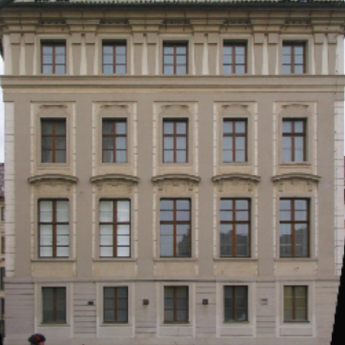
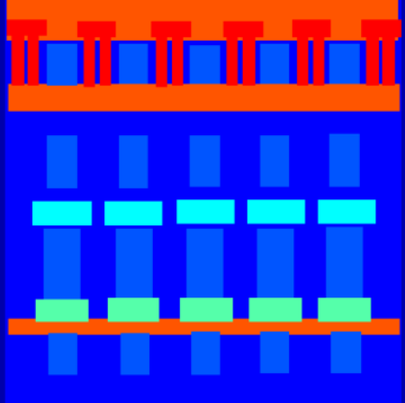
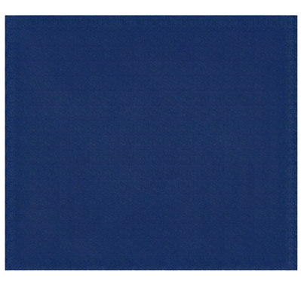


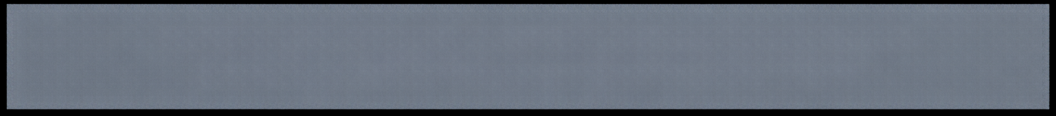
Problem Statement
Image-to-Image Translation
Model
semantic layouts define structure
and placement but not materials,
texture, or appearance
image-to-image translation learns
a mapping from structured layouts
to realistic facade photographs
manual visualisation of facade
appearance requires additional
time and design effort
Goal: generate a plausible facade image from a semantic layout (conceptual visualisation, not construction-ready output)

Slide 3

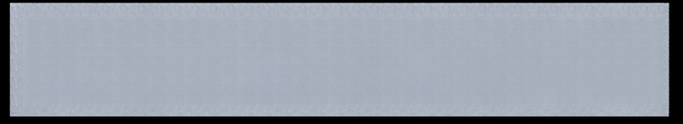

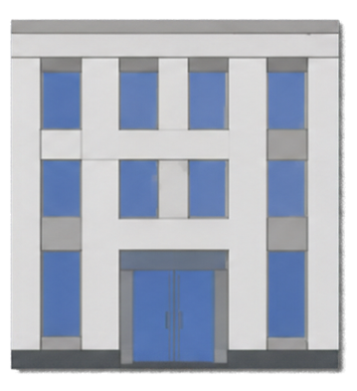
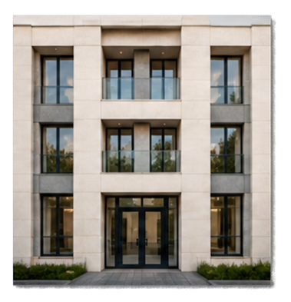


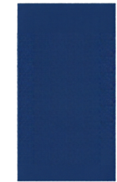


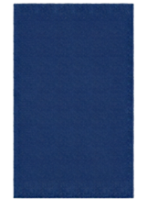




Objectives and Dataset
Input: semantic facade annotation (256 x 256 RGB)
Output: generated facade photograph
Semantic annotation
Matching photograph
The CMP Facade Database provides semantic annotations paired with real facade photographs.
Paired data is essential because the model learns a direct layout-to photo mapping and the L1 loss compares against the paired target.
Locate photographs and annotation files
Preprocess, resize to
256 x 256
and normalise to [-1, 1]
Split
80% train / 10% validation / 10% test
Download
dataset
Match corresponding pairs
256 x 256 RGB
256 x 256 RGB

Slide 4



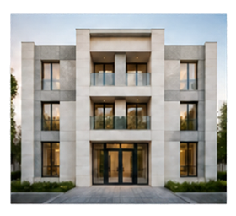

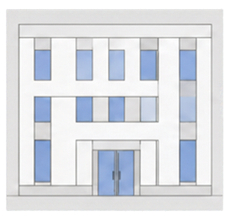
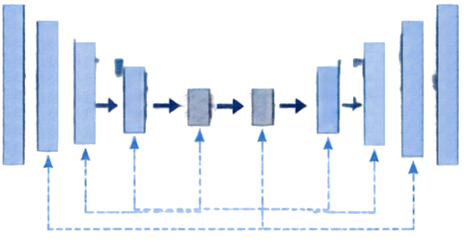







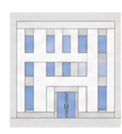
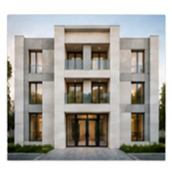
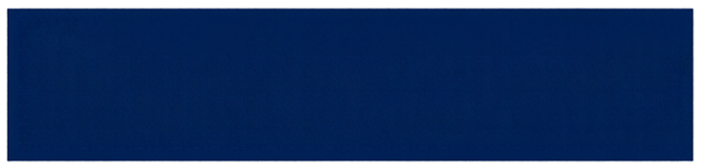
System Architecture
a conditional GAN framework that maps semantic layouts to realistic facades
U-Net Generator
Generated Facade
Semantic Layout
Encoder
Decoder
PatchGAN
Discriminator
Bottleneck
Real /
Fake
(per patch)
judges realism of local image patches, conditioned on
the layout
or
feedback
trains the
generator
U-Net encoder
compresses the
layout into features
Bottleneck compact
representation
U-Net encoder
reconstructs the
facade image
Skip connections
carry spatial detail from ancoder
to decoder
Real Facade
Semantic Layout → U-Net Generator → Generated Facade
PatchGAN Discriminator receives the layout concatenated with either the real photograph or the generated facade.

Slide 5













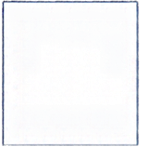

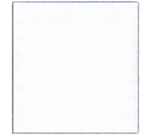
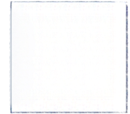










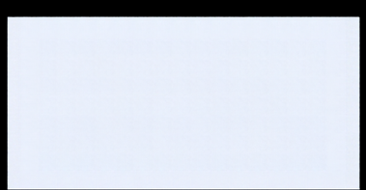
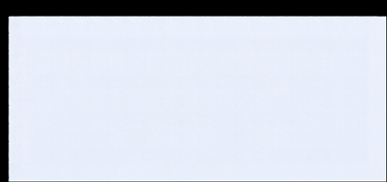
Methodology and Training Process
01
02
03
04
05
06
07
08
Paired
Dataset
Preprocessing
Generator Prediction
Discriminator Evaluation
Loss Calculation
Backpropagation and Optimisation
Checkpoint Selection
Final
Evaluation
L
=
L
+
100
x
L
Objective
G
GAN
1
GAN loss pushes outputs to look realistic
L1 loss keeps output close to the paired ground-truth photo
Discriminator learns to separate real pairs from generated pairs
Best generator checkpoint chosen by lowest validation L1 loss

Slide 6




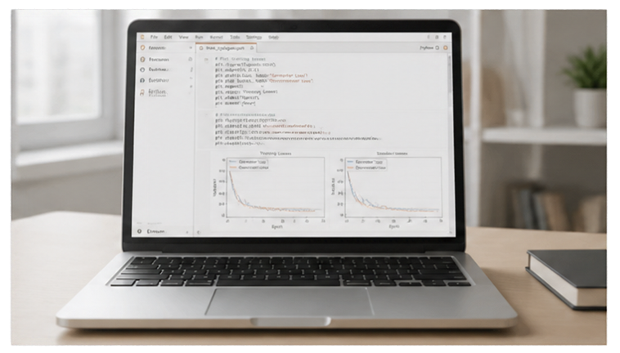





Framework
Generator / Discriminator
Images
PyTorch
U-Net / PatchGAN
256 x 256 RGB
normalised to [+1, 1]
Optimiser
L1 Weight
Configured Epochs
Adam
100
30
learning rate 0.0002
betə1 0.5
completed epochs to be confirmed from notebook
Data Split
Evaluation Metrics
Implementation and Experimental Setup
80% / 10% / 10%
MAE and SSIM

Slide 7






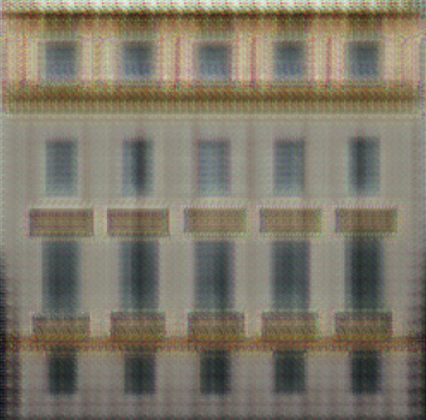




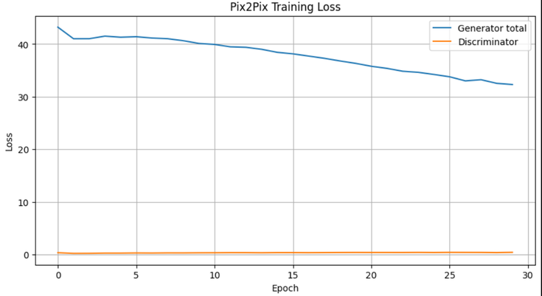
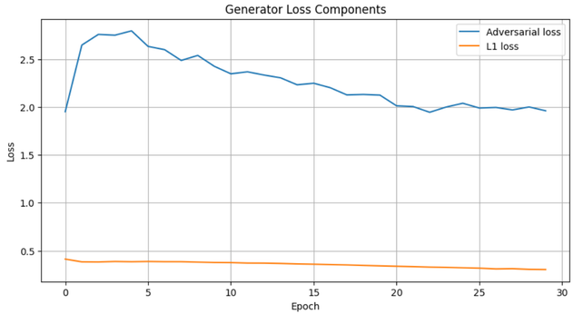
Results and Model Evaluation
Input semantic annotation
Ground-truth facade photograph
Generated prediction from the trained model
Quantitative evaluation metrics
Training loss curve
MAE
SSIM
0.1871
0.1456

Slide 8

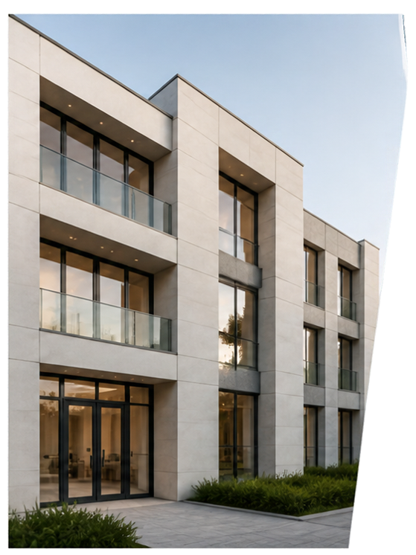
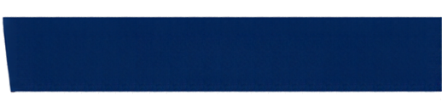



Limitations and Future Improvements
Limitations
Future Work
Dataset uses semantic annotations, not real CAD blueprints
Expand paired dataset diversity and refine training settings
Output quality depends on diversity and quality of paired data
Add baseline comparisons, perceptual metrics and human evaluation
GAN training can be unstable; outputs may show blur or artefacts
Build a CAD-to-rendering dataset for a genuine blueprint-to-facade extension
MAE and SSIM do not fully capture realism or architectural usefulness
Outputs are conceptual visualisations, not construction-ready

Slide 9






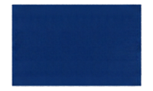


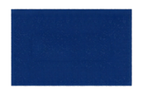

Conclusion and References
Semantic layouts capture structure but lack
realistic materials, texture, and appearance.
References
Problem
Isola, Zhu, Zhou, Efros.
Pix2Pix-style conditional GAN maps layouts
to realistic facade photographs.
1
Image-to-Image Translation with
Conditional Adversarial Networks.
CVPR 2017
Approach
U-Net generator learns image synthesis from
paired data; PatchGAN discriminator enforces
local realism and sharp details.
Architecture
Goodfellow et al.
2
Generative Adversarial Nets.
NeurIPS 2014
Data
Paired semantic layouts and facade
photographs are essential for effective learning.
Produces plausible facade images that reflect structure with realistic appearance, while
limitations remain in rare styles and fine details.
Tylecek and Sara.
Results
3
Spatial Pattern Templates for Recognition of Objects with
Regular Structure.
GCPR 2013 (CMP Facade Database)
Thank You

